Slide 1
CARDIAC TUMOURS
PRESENTER CHAIRPERSON
DR ZIDDI LINGGI DR SHIJOY
1ST YEAR SENIOR RESIDENT ASSISTANT PROFESSOR
DEPARTMENT OF CARDIOLOGY DEPARTMENT OF CARDIOLOGY

Slide 2
references
BRAUNWALD’S HEART DISEASES 12TH EDITION
FUSTER AND HURST THE HEART 15TH EDITION
ESC TEXTBOOK OF CARDIOVASCULAR MEDICINE, 3RD EDITION, VOLUME 2
Tyebally, S, Chen, D, Bhattacharyya, S. et al. Cardiac Tumors: JACC CardioOncology State-of-the-Art Review. J Am Coll Cardiol CardioOnc. 2020 Jun, 2 (2) 293–311.https://doi.org/10.1016/j.jaccao.2020.05.009
Bussani R, Castrichini M, Restivo L, Fabris E, Porcari A, Ferro F, Pivetta A, Korcova R, Cappelletto C, Manca P, Nuzzi V, Bessi R, Pagura L, Massa L, Sinagra G. Cardiac Tumors: Diagnosis, Prognosis, and Treatment. Curr Cardiol Rep. 2020 Oct 10;22(12):169. doi: 10.1007/s11886-020-01420-z. PMID: 33040219; PMCID: PMC7547967.
Joseph J et al. the 2021 WHO classification of tumours of the heart. Journal of thoracic oncology,vol 17,issue 4. p510-518,April 2022. https://doi.org/10.1016/j.jtho.2021.10.021

Slide 3
Cardiac tumours are rare
Mostly incidentally detected
Presents significant diagnostic and therapeutic challenges
Can be primary cardiac tumour or a secondary from carcinoma of other site

Slide 4
Autopsy incidence of primary tumour is 1:2000
Secondary tumour are 30 times more common than primary tumour

Slide 5
Primary tumours- 10% malignant, 90% benign
50% of benign tumours are myxoma: most common in adults
Rhabdomyoma: most common childhood benign cardiac tumour(50-60%)

Slide 6
Classification of cardiac tumours

Slide 7
DIFFERENTIAL DIAGNOSIS

Slide 8
CLINICAL FINDINGS

Slide 9
DIAGNOSTIC APPROACH
Etiology can be determined by 4 factors
Age at the time of presentation
Clinical probability
Location
Imaging investigation

Slide 12
BENIGN TUMOURS

Slide 13
MYXOMA
most common type of benign primary cardiac neoplasm
fourth and sixth decades of life, with a slight female predominance (3:1)
More than 80% of them are found in the left atrium
thought to arise from remnants of subendocardial cells or multipotential mesenchymal cells in the region of the fossa ovalis

Slide 14
may be familial and occasionally (3–10%) related to a particular syndrome called “the Carney complex,”
Most are asymptomatic
Positional dyspnea: dyspnea on lying to left side
Symptoms due to obstruction: syncope, dyspnea, pulmonary edema
Symptoms due to embolism

Slide 15
Non specific symptoms
Tiredness
Fever
Weight loss
Athralgia
Rashes

Slide 16
Laboratory findings
anemia increased erythrocyte sedimentation rate (ESR),
C-reactive protein and gamma globulin levels.
thrombocytopenia, clubbing, cyanosis, or Raynaud’s phenomenon (less common)

Slide 17
Physical examination
Systolic murmur (most common finding)
Tumor plop
Diastolic murmur( 15% of cases)

Slide 18
IMAGING
Cardiac myxomas are usually attached by a stalk to the atrial septum in the fossa ovalis
Lobulated margins
Cardiac myxomas will enhance with use of echocardiography contrast

Slide 19
On computed tomography (CT), a myxoma appears as a well-defined, ovoid, intracavitary mass with lobulated contours, and
low-attenuation lesion on contrast surrounded by enhanced intracardiac blood
On cardiac magnetic resonance (CMR) images
appear isointense on T1-weighted sequences
higher signal intensity on T2-weighted sequences

Slide 20
Postcontrast delayed imaging typically shows a heterogeneous enhancement pattern
HISTOPATHOLOGY
myxomas are yellowish, white, or brownish pedunculated masses frequently covered with thrombus at gross examination
tumor size can range from 1 to 10 cm showing a smooth surface in most cases

Slide 21
the tumors are characterized by lepidic cells in a myxoid stroma, Alcian-PAS positive
The only definitive treatment of cardiac myxoma is surgical removal
Lifelong follow-up is needed, as myxomas have some tendency to recur.

Slide 25
FAMILIAL ATRIAL MYXOMA
CARNEY COMPLEX
Autosomal dominant
Features includes
Cardiac myxoma
Skin pigmentation
Endocrine hyperactivity
PPKAR1A gene mutation

Slide 26
NAME syndrome: Naevi, Atrial myxoma, Myxoid neurofibroma, Ephelides
LAMB syndrome: Lentiginosis, Atrial myxoma, Mucocutaneous myxomas, Blue naevi
Makes up for about 7% of all cardiac myxomas
Presents at younger age
No female preponderance
Tendency to recur

Slide 28
LIPOMA
benign cardiac tumor( 3%)
tend to occur in the right atrium
Mostly asymptomatic but can cause obstructive symptoms
associated with older age, increased body mass, and female sex

Slide 29
IMAGING
echocardiographic appearance of lipomas varies with their location.
Lipomas in the pericardial space may be completely hypoechoic, have hypoechoic regions, or be completely echogenic intracavitary lipomas are homogeneous and hyperechoic
On CMR, have similar signal intensity to the surrounding fat on the chest wall on T1-weighted and T2-weighted images.

Slide 32
cardiac lipomas usually occur as single, well-encapsulated masses, though multiple lesions can occur
histopathologically composed of mature fat cells with occasional fibrous connective tissue and vacuolated brown fat.

Slide 33
Fibroelastoma
benign, endocardial growths that mostly involve valvular tissue, especially the aortic valve
Mean age is 70–80 years old with no sex differences
pedunculated masses with independent mobility and homogeneous speckled pattern
papillary fibroelastomas could be seen upstream or downstream from the valves but can also be present on other endothelial surface

Slide 34
Presents with embolic symptoms
Sudden death can occur if get wedged into coronary ostium
Surgical resection advised for larger left sided fibroelastomas
Right sided fibroelastomas are conservatively managed unless
Causes obstructive symptoms
Risk of embolization due to R→L shunt

Slide 35
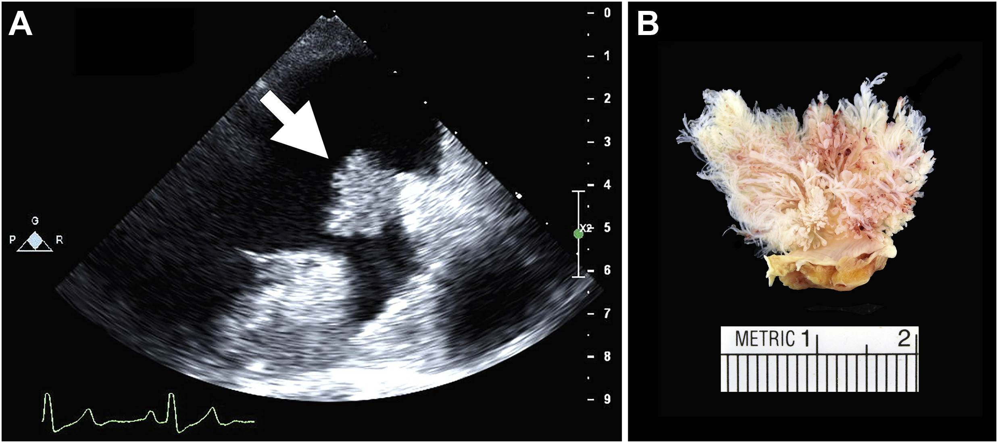

Slide 37
FIBROMA
benign proliferations
second most common intracardiac tumor in children
fibroma is located in the ventricle and interventricular septum
patients may present with chest pain, pericardial effusion, heart failure, or arrhythmias

Slide 38
associated with Gorlin syndrome
characterized by nevoid basal cell carcinoma, unusual brain tumors, skeletal abnormalities, and macrocephaly
On echocardiography, cardiac fibromas are homogeneous, appearing brighter than surrounding myocardium, and might incorporate hyperintense flecks suggestive of calcium
Fibromas generally show no contrast enhancement during perfusion imaging due to avascularity

Slide 40
after 7–10 min, they classically show intense hyperenhancement on late gadolinium enhancement
Cardiac fibromas appear well-circumscribed and manifest as tan nodules with a whorled appearance
tend to extend into adjacent myocardium

Slide 41
composed primarily of fibroblasts or collagen, with the typical “spindle cells
Large fibromas may require surgical resection
fibromas tend not to recur.

Slide 42
RHABDOMYOMA
most common benign cardiac tumor in children and arise most commonly in the ventricles
80% of them are found in association with tuberous sclerosis
Multiple in 90% of cases
arrythmogenic

Slide 43
2D echo: appear as a bright ventricular mass protruding. small, wellcircumscribed (multiple) nodules or a pedunculated mass in a cardiac cavity
these lesions are isointense/normal on T1- weighted images
hyperintense on T2-weighted images and typically have minimal delayed enhancement

Slide 44
Cardiac rhabdomyomas are composed of enlarged, vacuolated cardiomyocytes and are characterized by typical spider cells, polygonal myocytes with prominent sarcoplasmic clearing
Undergoes spontaneous regression; follow up is the key

Slide 46
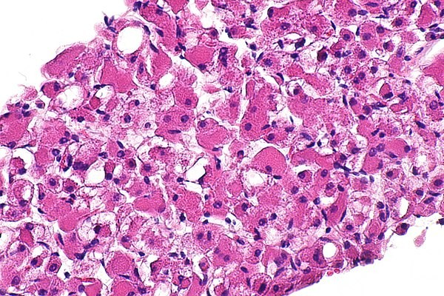

Slide 47
Hemangioma
account for 2% of primary cardiac neoplasms
any age group
benign neoplasms with the potential for recurrence
occur more frequently in the ventricles and in about 30% of cases are multiple

Slide 48
occur more frequently in the ventricles and in about 30% of cases are multiple
TYPES
small capillaries (capillary hemangioma)
large vessels (cavernous hemangioma, the most common)
dysplastic (cirsoid aneurysm)

Slide 49
HAMARTOMA
occur mostly in men (2:1), the mean age is 25 year
a possible cause of sudden death
it appears as a homogeneous, intracardiac, poorly circumscribed mass that seems a myocardial scar

Slide 50
Cystic Tumor of the Atrioventricular Node
involves the atrioventricular node selectively
also known as tawarioma or celothelioma (mesothelioma of the AV node)
The mean age of clinical presentation is nearly 40 years
A total of 75% of patients present with complete and 15% with incomplete AV block, whereas in 10%, sudden death is the first clinical manifestation

Slide 51
The tumor appears multicystic, with size varying from 2 to 20 mm
the tumor is located on the right side of the central fibrous body, infiltrating and compressing the AV node
Diagnosis is usually achieved at postmortem or after cardiac transplantation through histological examination of the conduction system but occasionally in vivo or during surgical resection

Slide 53
PARAGANGLIOMA
Arises from neural crest cells of sympathetic and parasympathetic chains
The tumor may be located in the pericardial space with no intracardiac extension
located around the roof of the left atrium and aortic root involving the cardiac structures
Two types : secretory and non secretory

Slide 54
2D echo: echogenic mass with broad base
CT: marked enhancement with contrast imaging
MRI: T2 hyperintense
Positive on PET imaging
coronary CT angiogram or cardiac catheterization is necessary looking for large feeding vessels

Slide 55
coronary angiogram in these patients shows a characteristic“tumor blush”

Slide 56
Surgical resection is the treatment of choice
Adequate alpha blockade followed by beta blockade required prior to resection of secretory tumour

Slide 57
Malignant cardiac tumours

Slide 58
angiosarcoma
malignancies of endothelial cells
the most common primary differentiated cardiac neoplasms
affect individuals aged 40–50 years
occur most commonly in the right atrium

Slide 59
Patients typically present with symptoms of right heart failure, shortness of breath due to hemopericardium, and palpitations secondary to supraventricular arrhythmias
IMAGING
On echocardiography, angiosarcomas appear as a dense and irregular mass, often nonmobile and broad-based, with endocardial to myocardial extension
On T1-weighted imaging : isointense lesions with multiple nodular areas of high intensity, often portrayed as having a “cauliflower” appearance
low-attenuation, irregular, intracavitary mass mostly involving the right atrial free wall

Slide 60
heterogeneous enhancement pattern with intravenous iodinated contrast
Macroscopically, there are two morphologic variants
The “focal” variety is typically a well-defined mass protruding into the right atrium
“diffuse” variety is a more extensive mass that rapidly infiltrates the right ventricle and pericardium that manifests with right-sided heart failure or tamponade

Slide 61
HISTOPATHOLOGY
angiosarcomas consist of rapidly proliferating, extensively infiltrating anaplastic cells derived from blood vessels and lining irregular blood-filled spaces
Extremely poor prognosis

Slide 63
CARDIAC LYMPHOMA
extranodal lymphomas
arise in both immunocompetent and immunocompromised
Men are affected twice as often as women, with most patients aged > 60 years
Predilection for right atrium
Echocardiography will often show pericardial effusion

Slide 64
Clinical symptoms
Rhythm disorders
Restrictive cardiomyopathy
Heart failure

Slide 65
On CT imaging and CMR imaging, the findings are relatively nonspecific
hypermetabolic on positron emission tomography (PET) imaging
The majority of patients have diffuse large B cell non-Hodgkin lymphomas, usually expressing CD20
Cardiac lymphomas are associated with an ominous outcome

Slide 66
Undifferentiated Pleomorphic Sarcoma
most frequent primary cardiac malignancy
occur mostly in the left atrium but can develop in any chamber
occur mainly in adults
Diagnosis of exclusion
IMAGING
appear as large, irregular, intracavitary masses on CT with low-attenuation which usually appear
isointense on T1-weighted images and
hyperintense on T2-weighted images
heterogeneous, delayed enhancement pattern

Slide 67
HISTOPATHOLOGY
presence of typical spindle and polygonal (strap-like) cells that are filled with an abundant eosinophilic cytoplasm
desmin- and myoglobin-positive immunoreactivity

Slide 69
RHABDOMYOSARCOMA
Most common pediatric cardiac malignancy
Often involves valves
No chamber prediliction
Often bulky
rhabdomyoblasts containing abundant glycogen and expressing desmin, myoglobin, and myogenin

Slide 70
difficult to treat and are often rapidly fatal
Cardiac MRI:
T1 weighted: isointense
T2 weighted: hyperintense
combination of surgery, chemotherapy, and radiation therapy standard approach of treatment

Slide 71
Vincristine, dactinomycin, and cyclophosphamide are the standard regimen for rhabdomyosarcoma
Radiation therapy is administered to achieve local control in patients with residual microscopic or gross disease following surgery and chemotherapy

Slide 72
LEIOMYOSARCOMA
Aggressive tumour
Arises from posterior part of left atrium
Asymptomatic till advanced stage
Invades myocardium→ causes arrythmias
Usually invade mitral valve and pulmonary vein

Slide 73
Appears as low attenuated lobulated mass on CT
Survival without treatment- 6months
Palliative treatment with resection given in advanced stages

Slide 74
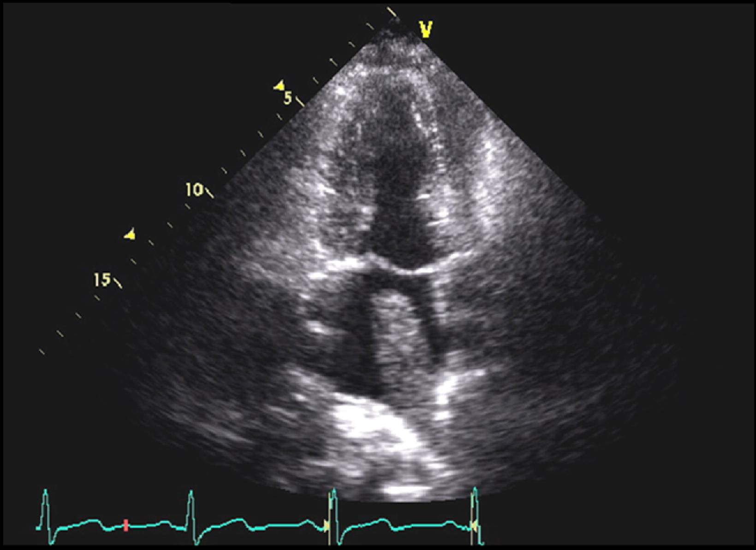
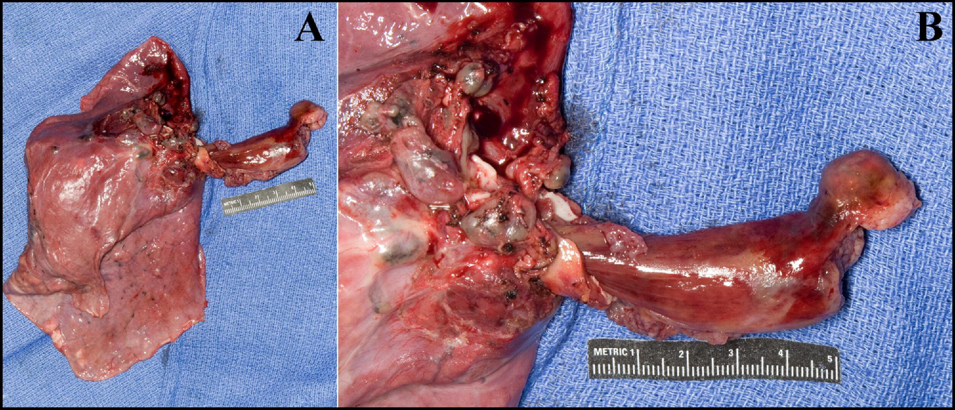

Slide 75
OSTEOSARCOMA
Predominantly found in left atrium
Consists of sheets of born forming cells
Highly invasive and infiltrate myocardium→ arrythmias
Infiltrates pericardium→ pericardial effusion

Slide 76
2D ECHO: asymmetrical internal echoes
CT: low attenuation
Poor prognosis

Slide 77
MESOTHELIOMA
Rare
Presents with pericardial effusion
Male preponderance (2:1)
Assumed association with asbestos exposure
Median age: 45 years
Symptoms: dyspnea, fever, arrythmias
Chest radiograph typically shows enlarged cardiac silhouette with pericardial effusion
2d echo shows pericardial effusion, tumour encasing the heart

Slide 78
CMR AND CT dhows multiple enhancing mass coalescing to envelope pericardial space
Microscopic evaluation needed for confirmation
Highly aggressive with poor prognosis
Post diagnosis survival is 6 months

Slide 79
Difficult to resect completely and hence palliation required

Slide 80
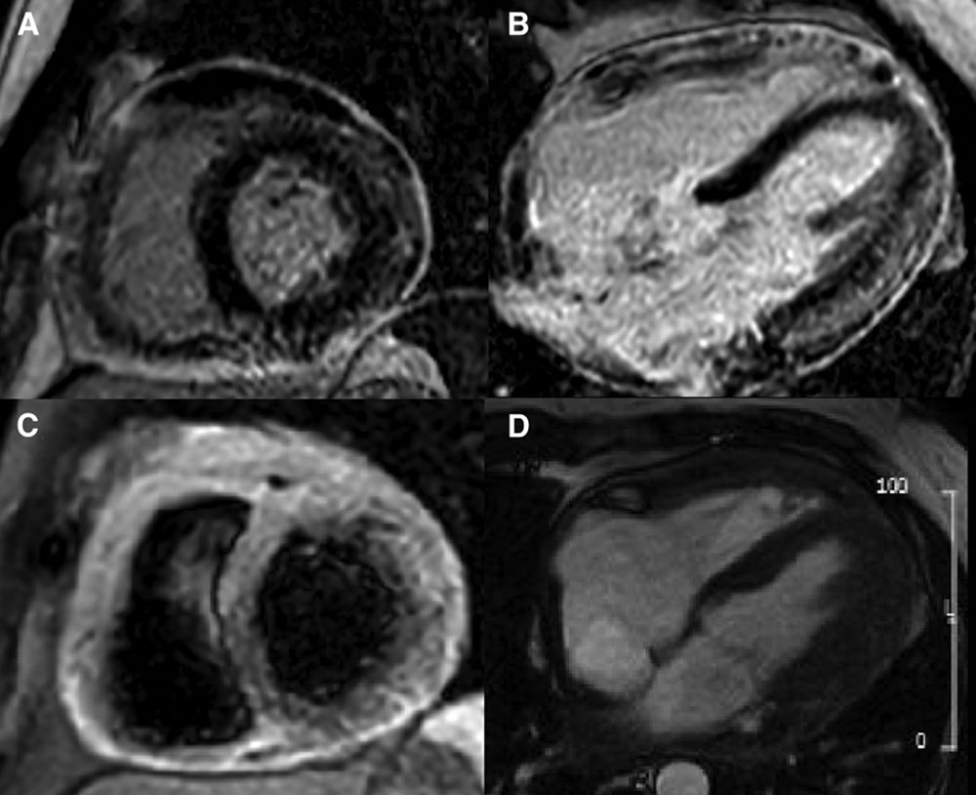
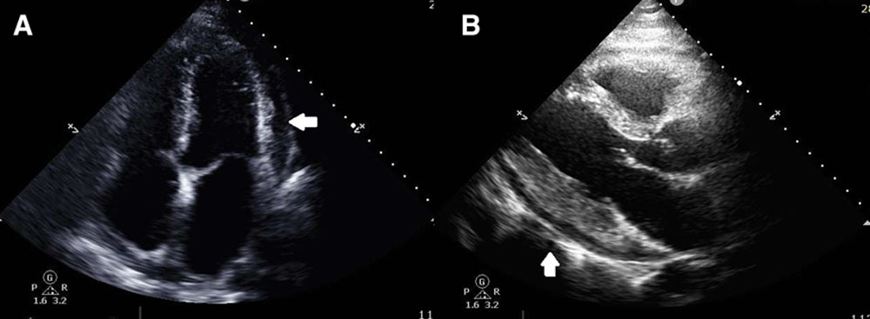

Slide 81
SECONDARY CARDIAC TUMOURS
Upto 12% of cancer patient have cardiac or pericardial metastasis
Most are clinically silent
Metastastic spread to heart can occur from multiple tumors
pleural mesothelioma (48.4%)
melanoma (27.8%)
lung adenocarcinoma (21%)
breast carcinoma

Slide 82
Cardiac invasion could be through
Direct invasion
Hematogenous spread: involves myocardium
Lymphatogenous spread: involves pericardium

Slide 84
May present as pericardial effusion
Intra cardiac or intra cavitatory invasion can lead to mechanical symptoms
In CMR: T1 weighted; hypointense
T2 weighted: hypertintense
FDG PET scan: needs stringent preparation

Slide 85
Treatment focuses on the primary tumour
Resection is not done unless severe hemodynamic complication occurs due to the secondary itself

Slide 86
conclusion
Cardiac tumour are rare
Secondary cardiac tumour are 20-30 times more common than primary tumour
Can remain asymptomatic for most of the time but can cause plethora of symptoms depending on the location, size and infiltration
Surgical resection is done for benign cases
Malignant and metastatic tumours have ominous prognosis

